Slide 1

KEYLOGGER PROJECT

Slide 2
Presented By:
P. Sakthi, 3rd-year , Computer Science and Engineering (CSE) , Universal College Of Engineering And Technology - vallioor .

Slide 3
Outline:
Keyloggers
Keylogger diagram
Type of Keylogger
Keylogger used
Keylogger illegal vs legal
Problem statement
Result
Conclusion
Reference

Slide 4

What is keylogger?
A computer program that records every keystroke made by a computer user, especially in order to gain fraudulent access to passwords and other confidential information.

Slide 5
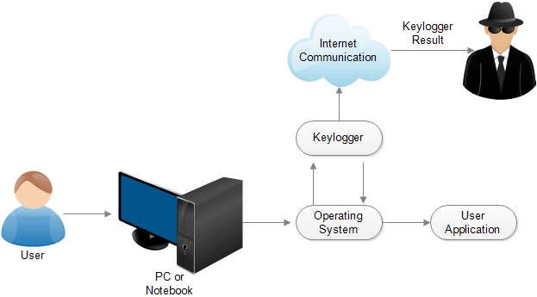
Keylogger diagram:

Slide 6
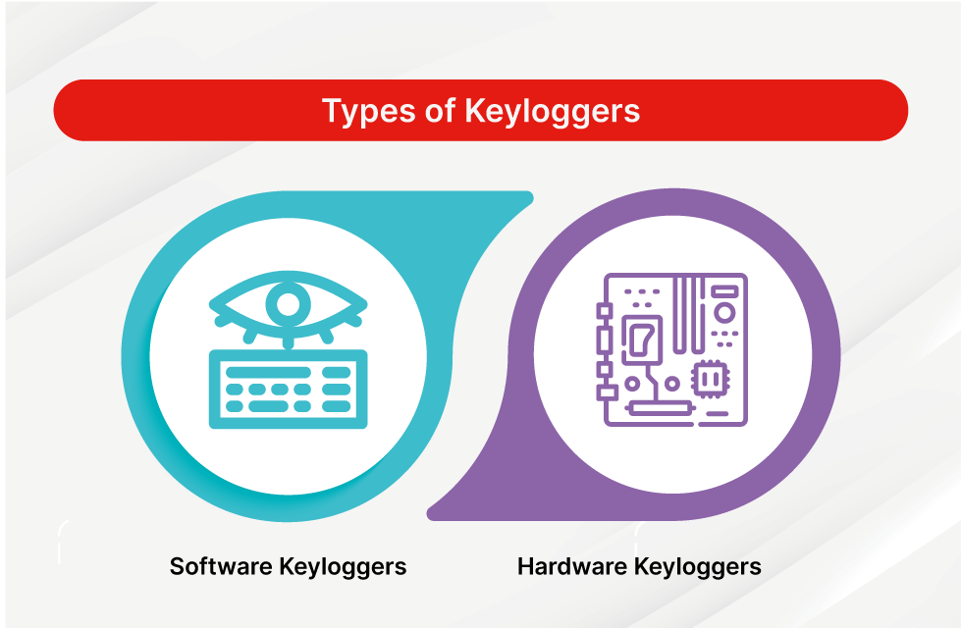
Types of Keylogger
The two types of keyloggers differ by the way that they log a keystroke. Both types of keyloggers can be used for malicious purposes, including credential theft and identity theft.
There are two types of Keylogger
Hardware
Software

Slide 7
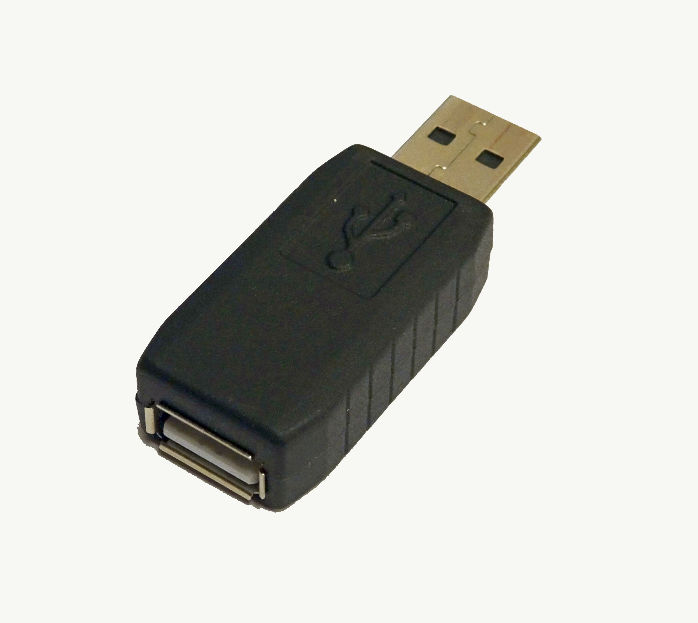
Hardware:
A hardware keylogger is a physical device, such as a USB stick, a PS2 cable, or a wall charger, which records keystrokes and other data.
These have typically been wired, but wireless sniffing types have appeared as well.

Slide 8

Software
EyeZy is another remote monitoring software suite with great keylogging features alongside a full mobile phone data sync capability.
Each keystroke on the target device is captured, even if it's typed into a secure field like a password field.

Slide 9
Keyloggers used :
By employers to observe employees' computer activities.
By parents to supervise their children's internet usage.
By device owners to track possible unauthorized activity on their devices.
By law enforcement agencies to analyze incidents involving computer use.

Slide 10
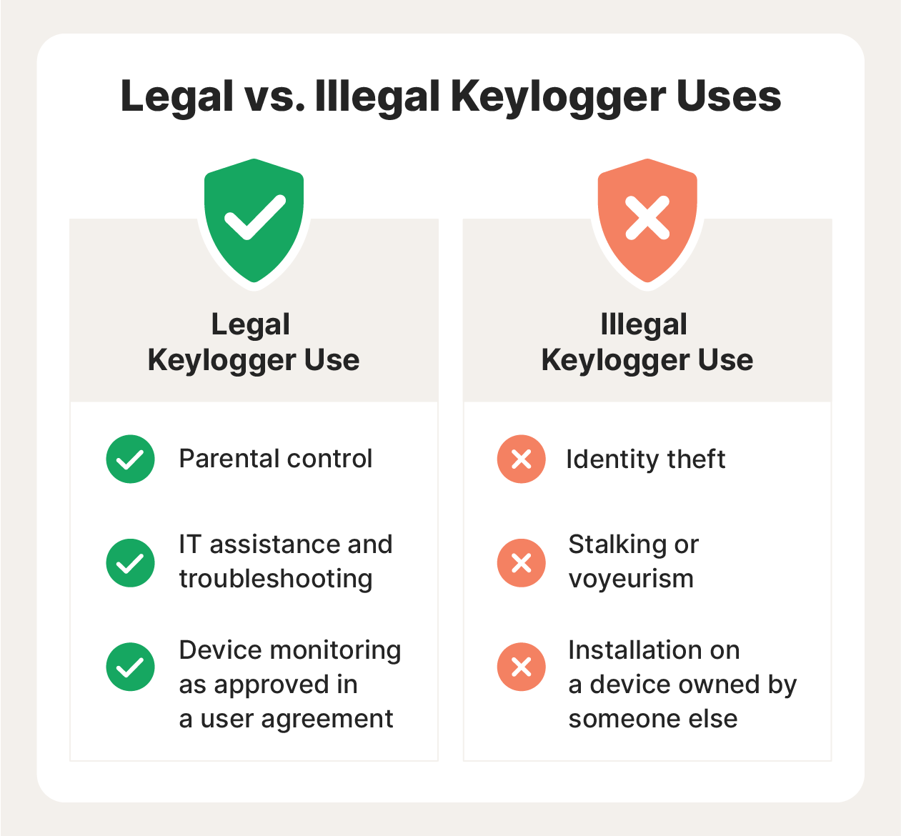
Keyloggers illegal vs legal:
While keylogging tools are not necessarily illegal, they are often used illegally by cybercriminals, identity thieves, or other malicious actors to surreptitiously steal information or track activity without someone's consent.

Slide 11
Problem Statement:
It's challenging to covertly install a hardware keylogger on another person's device.
To tackle this issue, We are therefore using a software keylogger that can be remotely installed on a person's PC to resolve this problem.

Slide 12
Result:
A software keylogger is put on a computer when the user downloads an infected application.
Once installed, the keylogger monitors the keystrokes on the operating system you are using, checking the paths each keystroke goes through.
In this way, a software keylogger can keep track of your keystrokes and record each one.

Slide 13
Conclusion:
Keyloggers are a potent threat to both individuals and enterprises, with the potential to cause significant harm if left undetected.
Understanding the nature of keyloggers, their methods of infiltration, and the dangers they pose is crucial for maintaining a secure digital environment.

Slide 14
Reference:
Keyloggers are programs that run as a background process on a computer or other device and collect keystrokes as a user types on their keyboard.
They can be malicious or used with good intentions, depending on the goals of the person installing them.

Slide 15
Thank you

